Slide 1
Result
김민준
2021.11.12

Slide 2
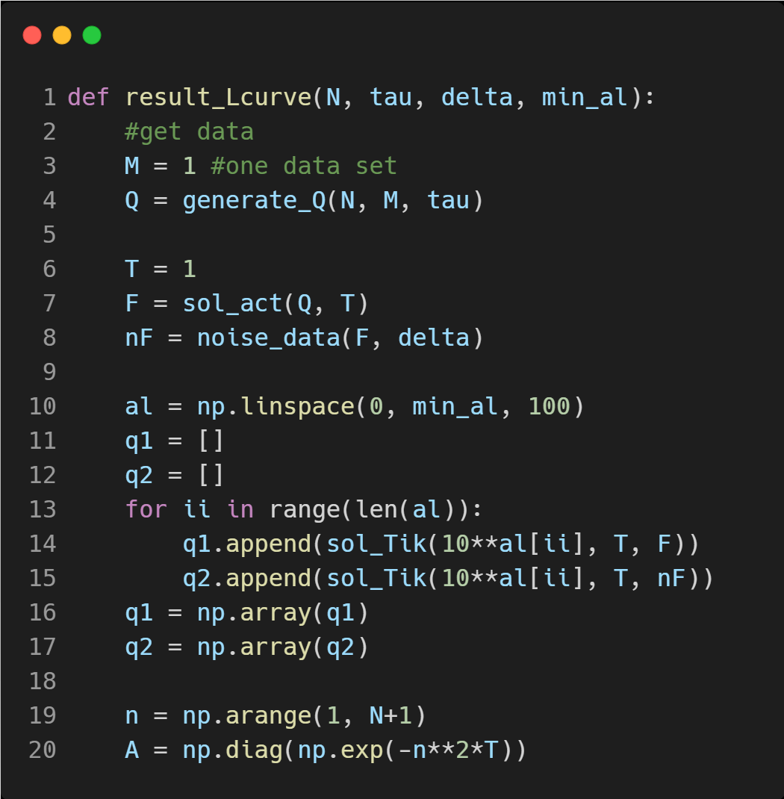
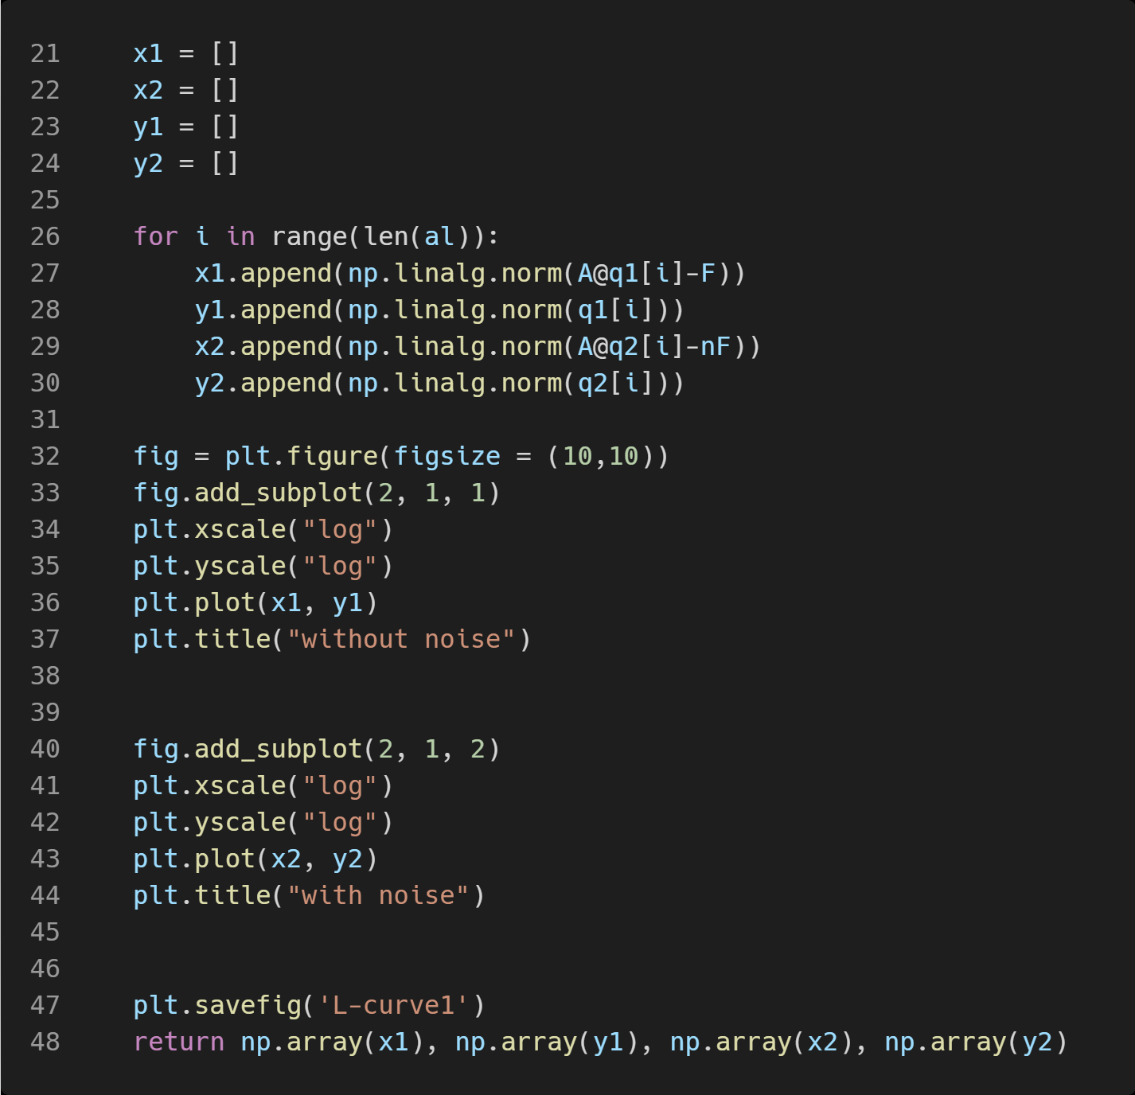
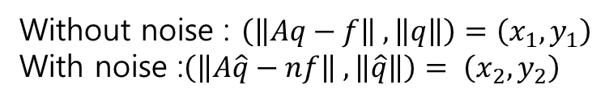
CODE
Without noise : $\left(\left\|Aq−f\right\| ,\left\|q\right\|\right)=\left(x_{1}, y_{1}\right)$
With noise :$\left(\left\|A\hat{q}−nf\right\| ,\left\|\hat{q}\right\|\right)= \left(x_{2}, y_{2}\right)$

Slide 3
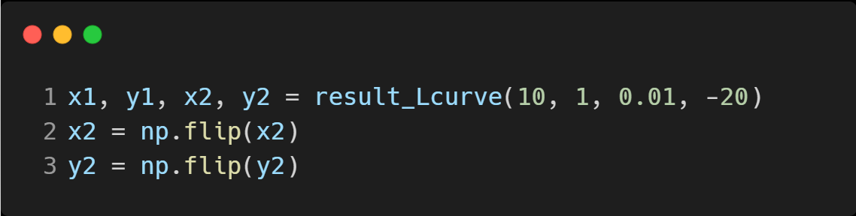
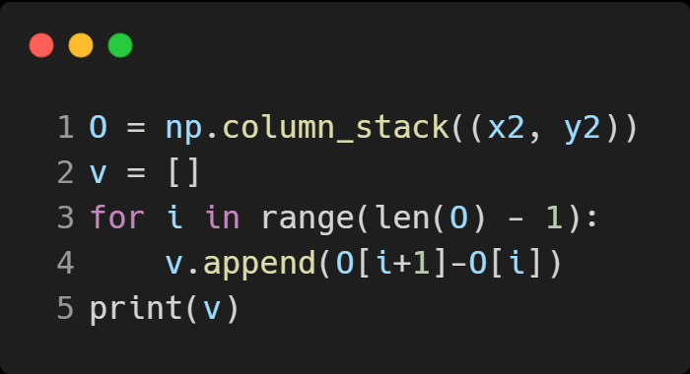
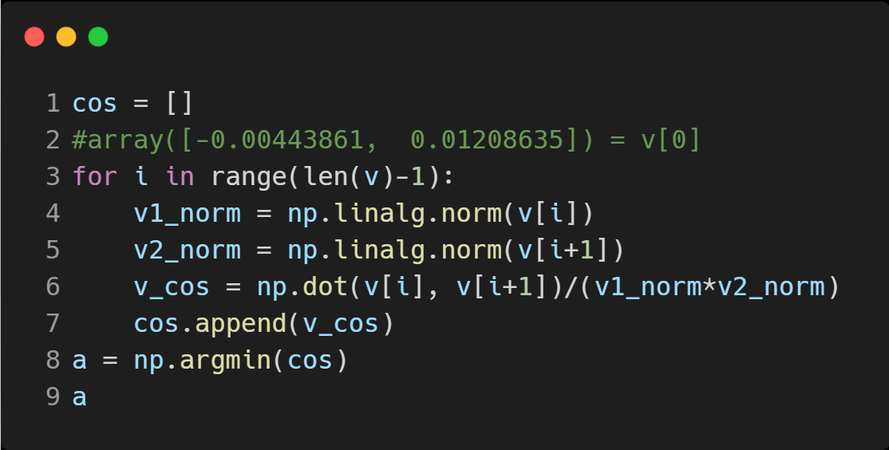
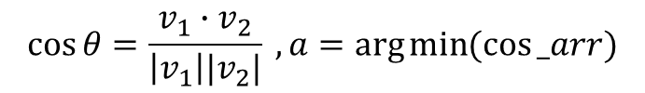
CODE
$$\cos{θ}=\frac{v_{1}∙v_{2}}{\left|v_{1}\right||v_{2}|} , a=\arg{\min{(\cos{_arr})}}$$

Slide 4
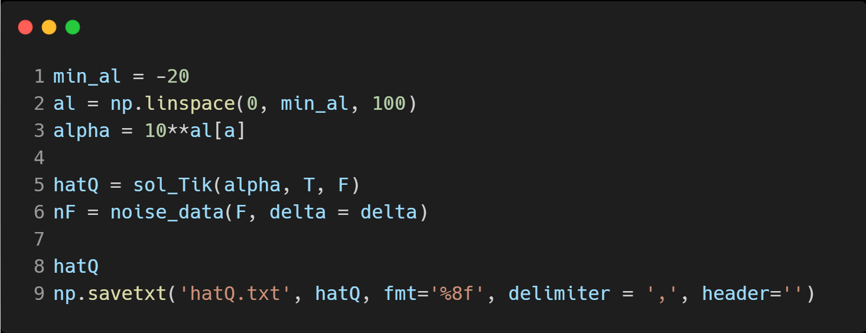
CODE

Slide 5
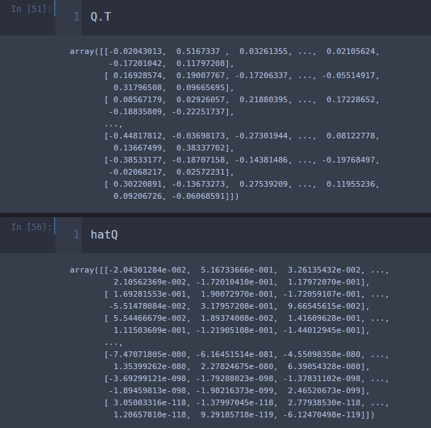
Q, hatQ : N = 12
Q shape = (12, 100000)
Hat Q shape = (12, 100000)

Slide 6
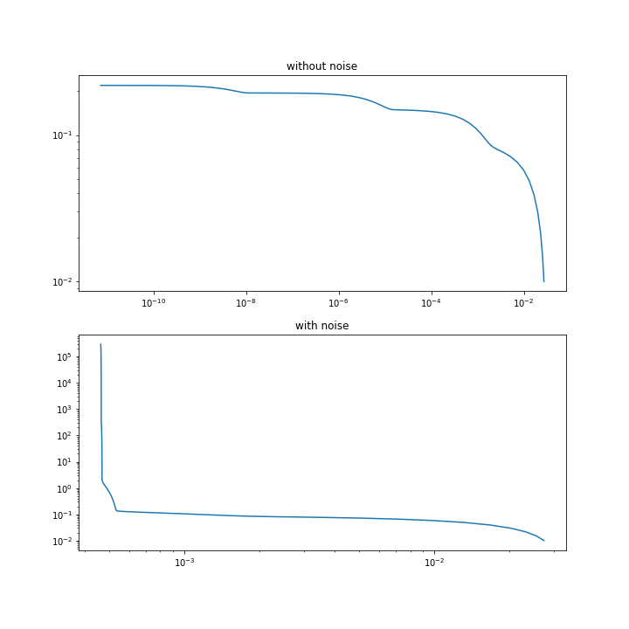
#1
Data
T = 1, delta = 0.01, tau = 1
N = 10, M = 100000

Slide 7
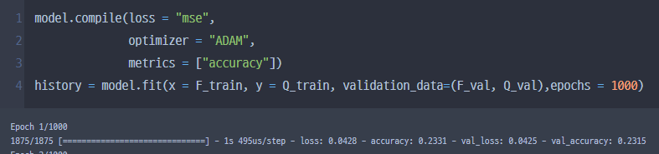
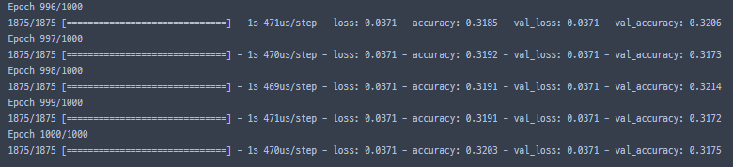

N = 10, M = 100000 Train(Q, F)
$$⋮$$

Slide 8
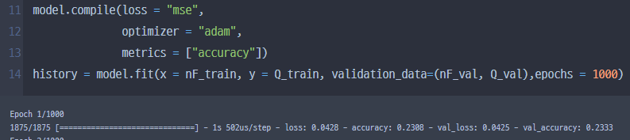
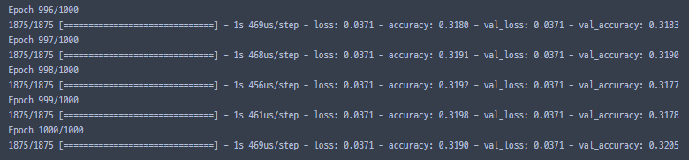
N = 10, M = 100000 Train(Q, nF)
$$⋮$$

Slide 9
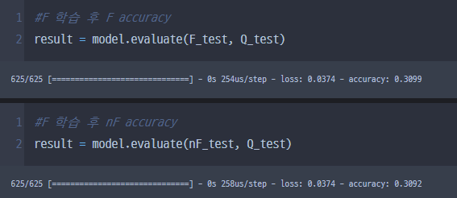
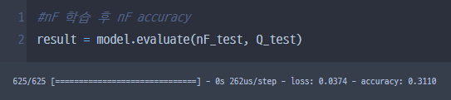
N = 10, M = 100000 Test data accuracy-Q

Slide 10
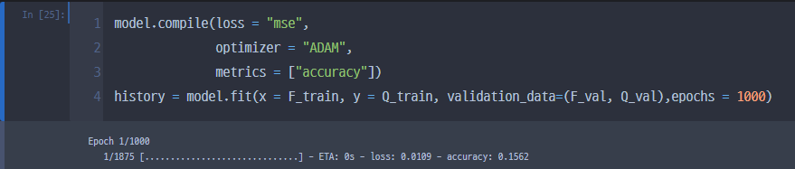
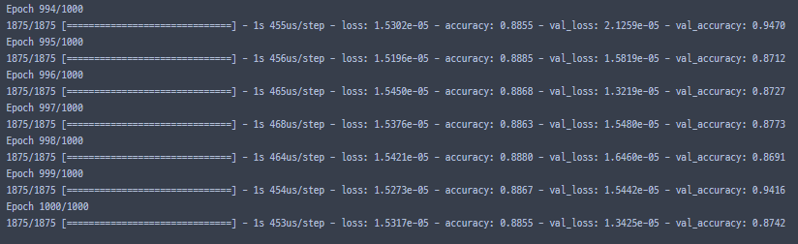


N = 10, M = 100000 Train(hatQ, F)
$$⋮$$

Slide 11
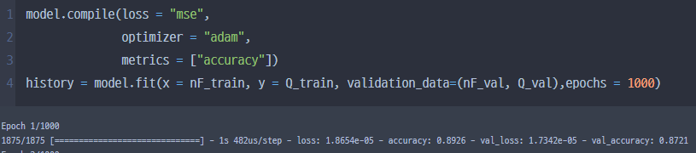
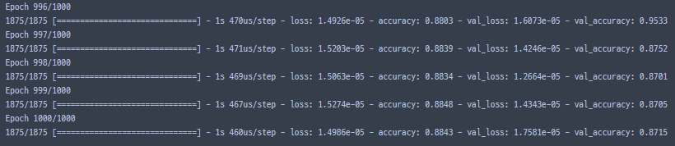

N = 10, M = 100000 Train(hatQ, nF)
$$⋮$$

Slide 12
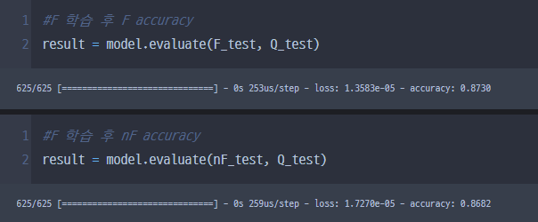
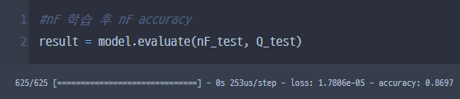
N = 10, M = 100000 Test data accuracy - hatQ

Slide 13
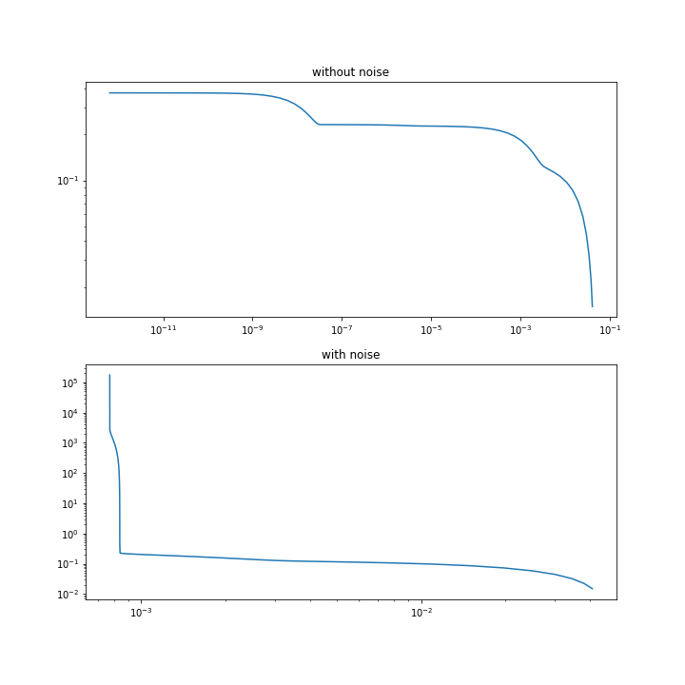
#2
Data
T = 1, delta = 0.01, tau = 1
N = 12, M = 100000

Slide 14
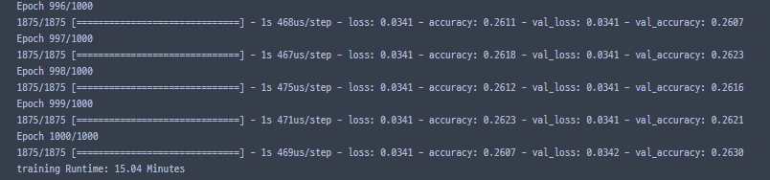
N = 12, M = 100000 Train(Q, F)
$$⋮$$

Slide 15
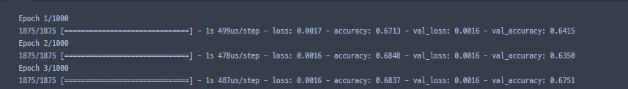
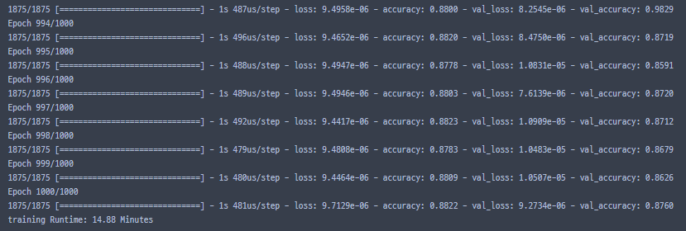

N = 12, M = 100000 Train(hatQ, F)
$$⋮$$

Slide 16
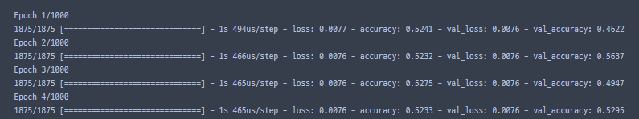
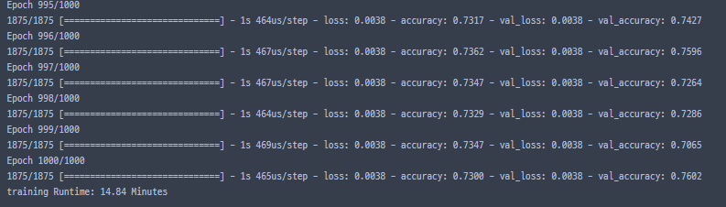

N = 12, M = 100000 Train(hatQ, nF)
$$⋮$$

